Slide 1
GenAI and financial data alert systems
GenAI Insight Overlays
Client: Alvarez & Marsal
David Velasquez david.velasquez.24@ucl.ac.uk

Slide 2
Project Scope - Implementation
Report Parts | Sales Manager | CFO
Retrieve high-level data (e.g., Sales trend, filtered, over time)
Retrieve detailed data (e.g., Sales by product for the last period)
Simple Sales forecasts based on current trends
Retrieve changes in detailed data that explain current trends
Recommend potential actions to remedy negative trends
Sales forecasts based on the remedy action
Customized email body based on report
Data Sources
CSV File Retrieval Agent
Azure Database Retrieval Agent | Not Used
File Information Retrieval Agent (e.g., company reports)
Web Search Agent
Frontend
Frontend to configure a single run internal for all requests
Frontend for defining report scope (e.g., sales region)
Frontend to configure emails to receive report
Not relevant with anonymized data

Slide 3
Final Detailed Workflow Models used: o4-mini and gpt-4o-mini
Direct call to LLM
Single-agent
Multi-agent Flow

Slide 4
Frontend Demo…

Slide 5
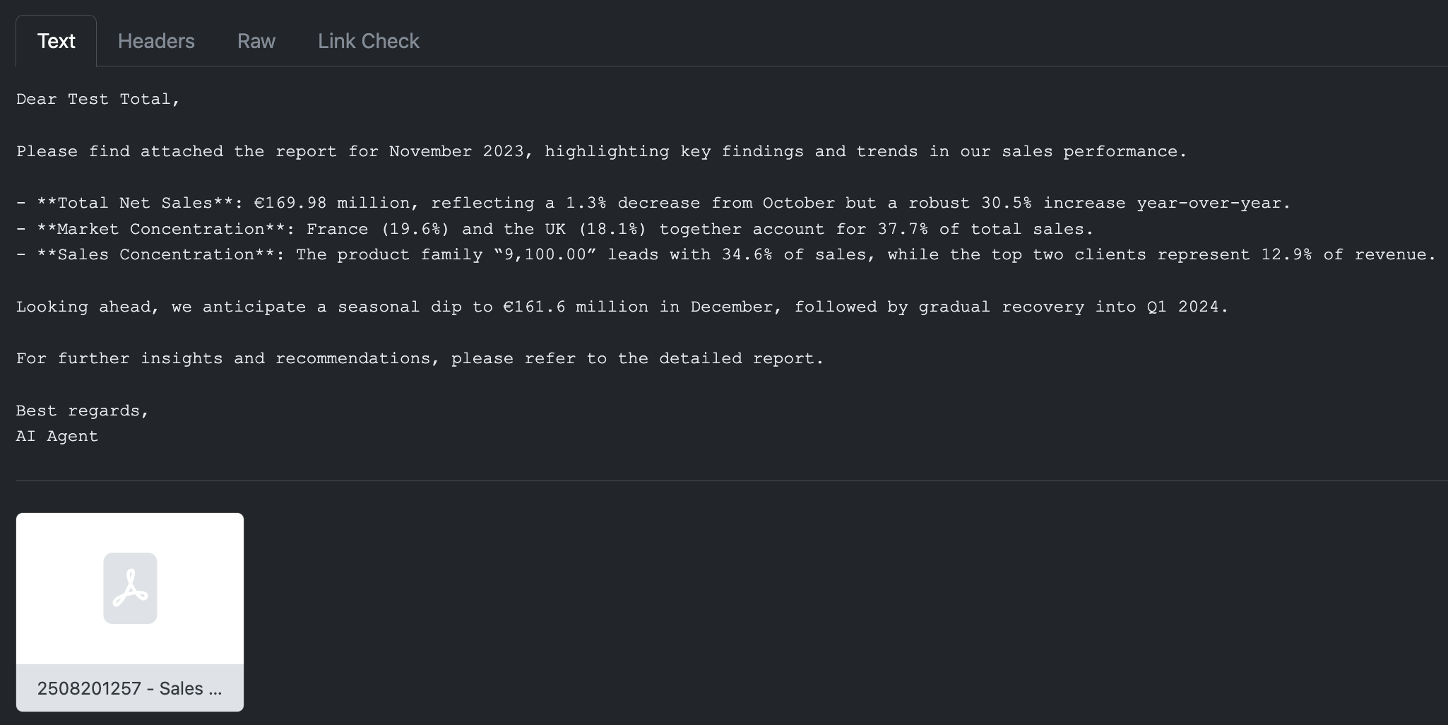
…Sample Email Output

Slide 6
Thank You!
GitHub: https://github.com/davidve0206/ai-analyst/

